Slide 1
DEPLOYING WORDPRESS WEB APPLICATION USING DOCKER IN AMAZON WEB SERVICES

Slide 2
INTRODUCTION
We'll deploy WordPress via docker-composer onto AWS EC2 instance (t2.micro) and access it with domain name (deployguru.tech) defined in Route53.
WordPress is the easiest way to manage and create content. Its flexibility is loved by authors: with a couple of plugins, you can do everything from hosting a cute kitten’s photo gallery to hosting an e-commerce site.
Let’s face it: seen from the IT guy point of view, WordPress is a technical nightmare. When someone has to deal with it the horror begins: scalability is challenging, installation isn’t scripted and a LAMP stack is not always easy to maintain.
In this article we’ll give you some technical hints and examples to ease your relationship with WordPress in a cloud environment based on AWS.
We'll try to use as many AWS managed services as we can to be able to offload boring and dangerous tasks.

Slide 3
PRE-REQUISITES
Amazon Web Services Account
GitBash Tool
GitHub Account
Steps to creating the infrastructure in this pipeline/module
Creating and launching an EC2 Instance with AMI – Amazon Linux 2
Installing GIT, Docker and related repos
Creating Docker images with help of YAML scripting
Creating EIP for launching the output of the project statically.

Slide 4
What is AWS
Amazon Web Services (AWS) is the world’s most comprehensive and broadly adopted cloud platform, offering over 200 fully featured services from data centers globally. Millions of customers—including the fastest-growing startups, largest enterprises, and leading government agencies—are using AWS to lower costs, become more agile, and innovate faster.
What is WordPress?
WordPress is a free and open-source content management system written in PHP and paired with a MySQL or MariaDB database with supported HTTPS. Features include a plugin architecture and a template system, referred to within WordPress as Themes. WordPress is a content management system (CMS) that allows you to host and build websites. WordPress contains plugin architecture and a template system, so you can customize any website to fit your business, blog, portfolio, or online store.

Slide 5
What is GitBash?
Git Bash is an application for Microsoft Windows environments which provides an emulation layer for a Git command line experience. Bash is an acronym for Bourne Again Shell. A shell is a terminal application used to interface with an operating system through written commands.
What is GitHub?
GitHub is a code hosting platform for version control and collaboration. It lets you and others work together on projects from anywhere. This tutorial teaches you GitHub essentials like repositories, branches, commits, and pull requests.

Slide 6
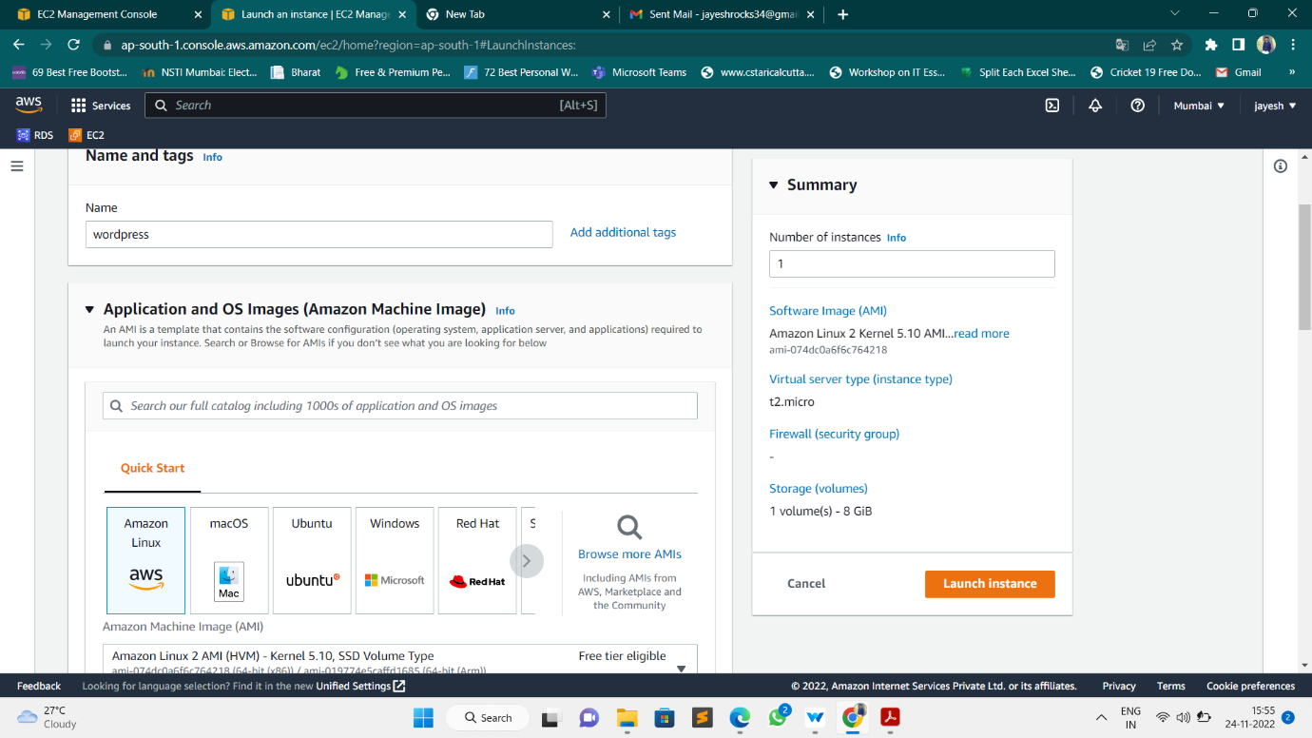
Now Creating and launching an Amazon Linux EC2 instance
Choosing an AMI – Amazon Linux 2 AMI

Slide 7
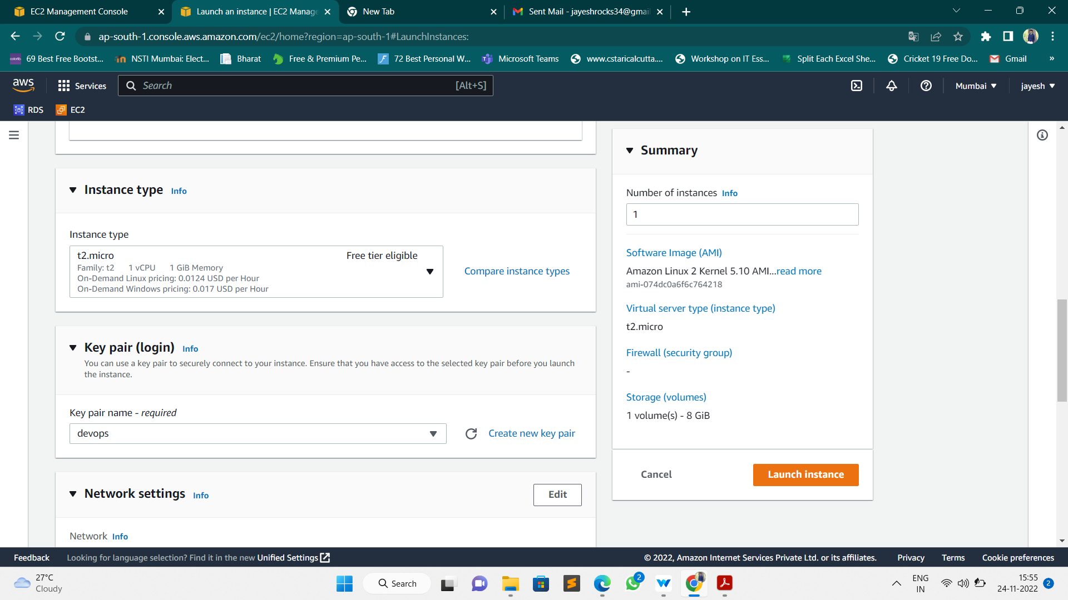
Choose an Instance Type
Select an Existing keypair or create a new key pair

Slide 8
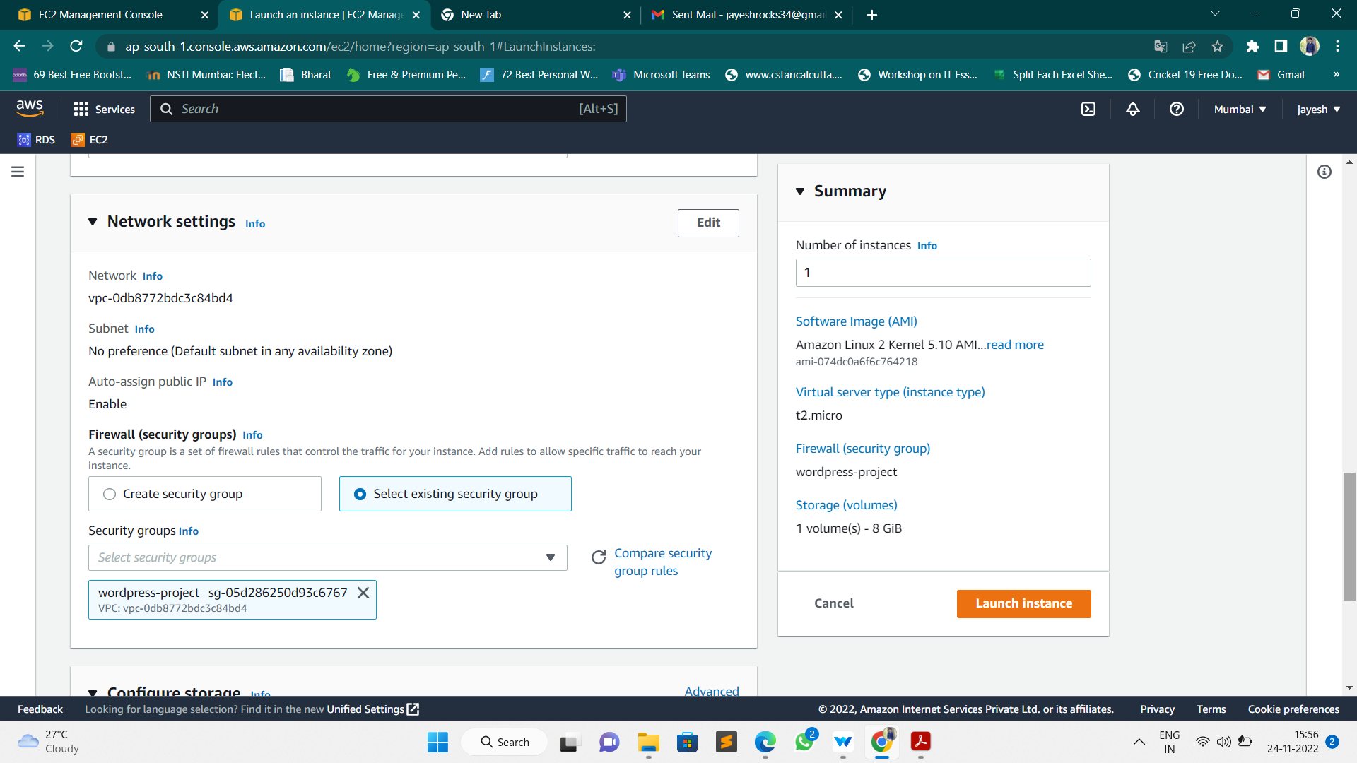
Configure Security Group

Slide 9
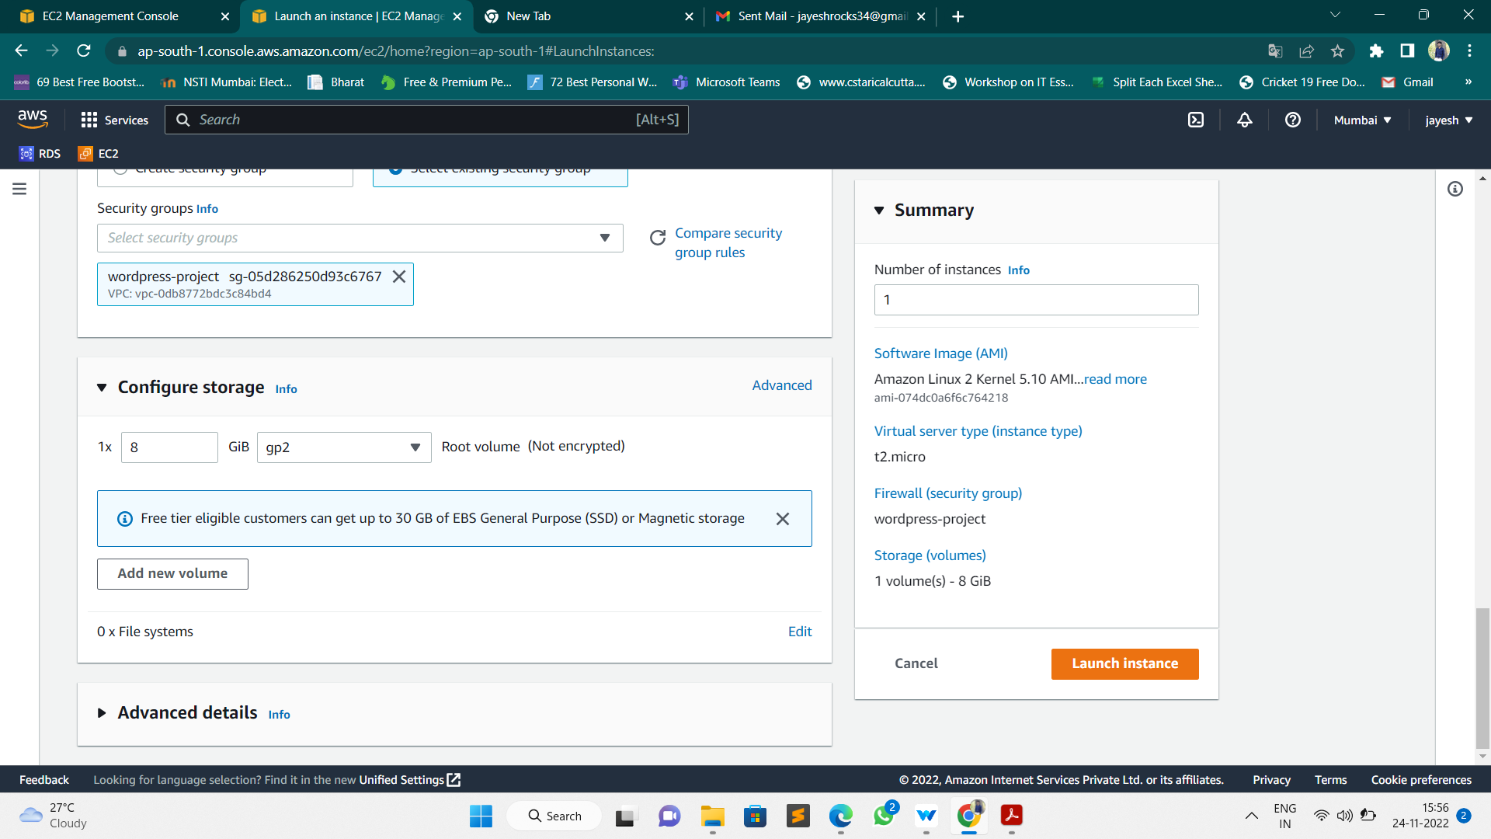
Configure Storage

Slide 10
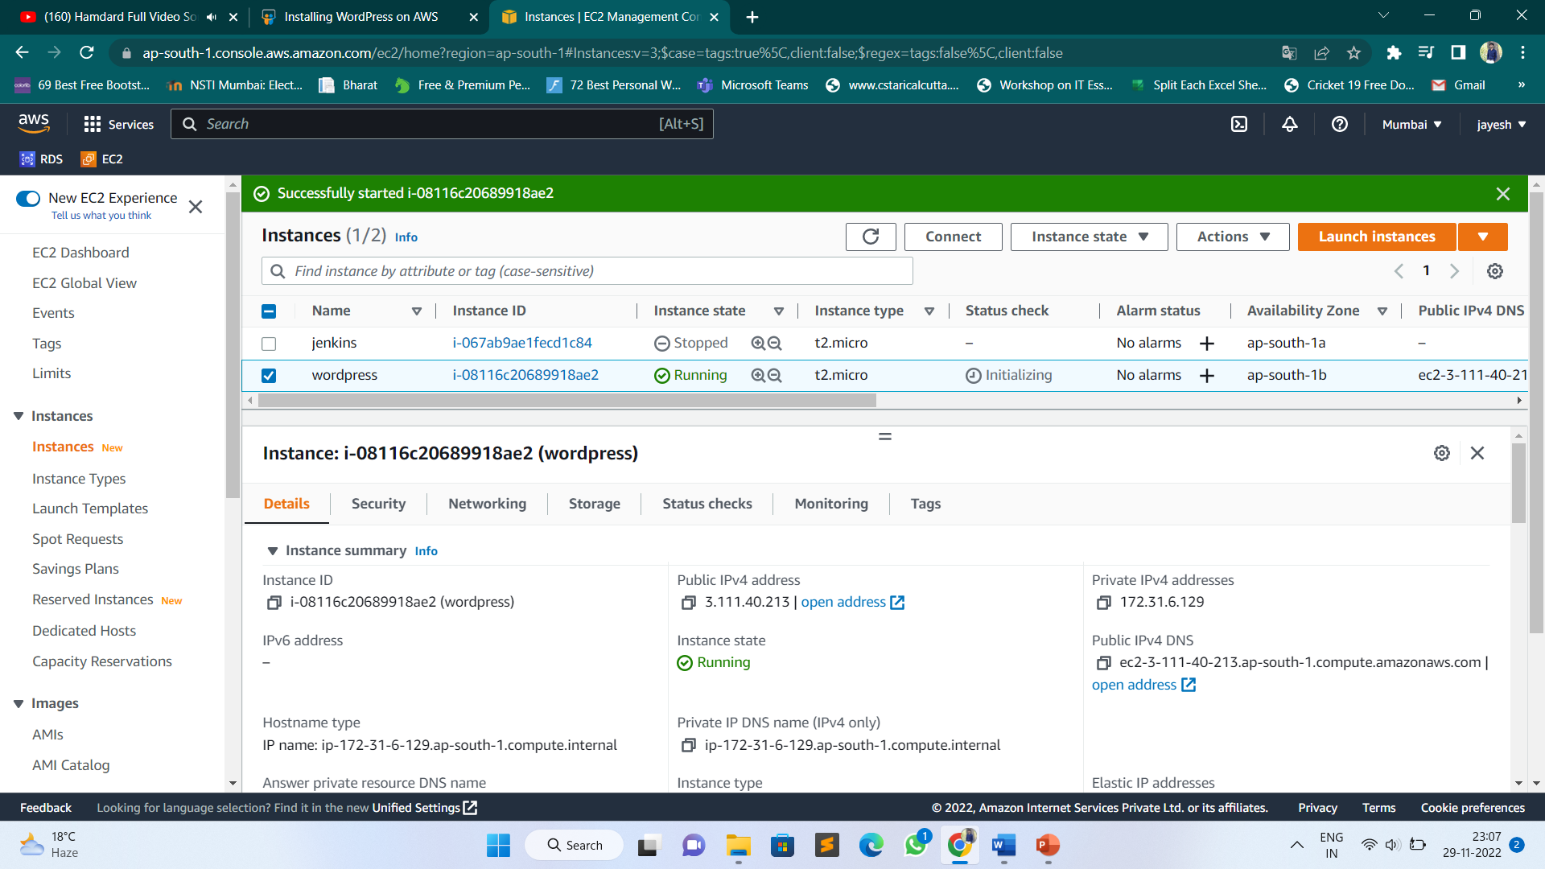
Finally, Instance launched a WordPress-Server Instance

Slide 11
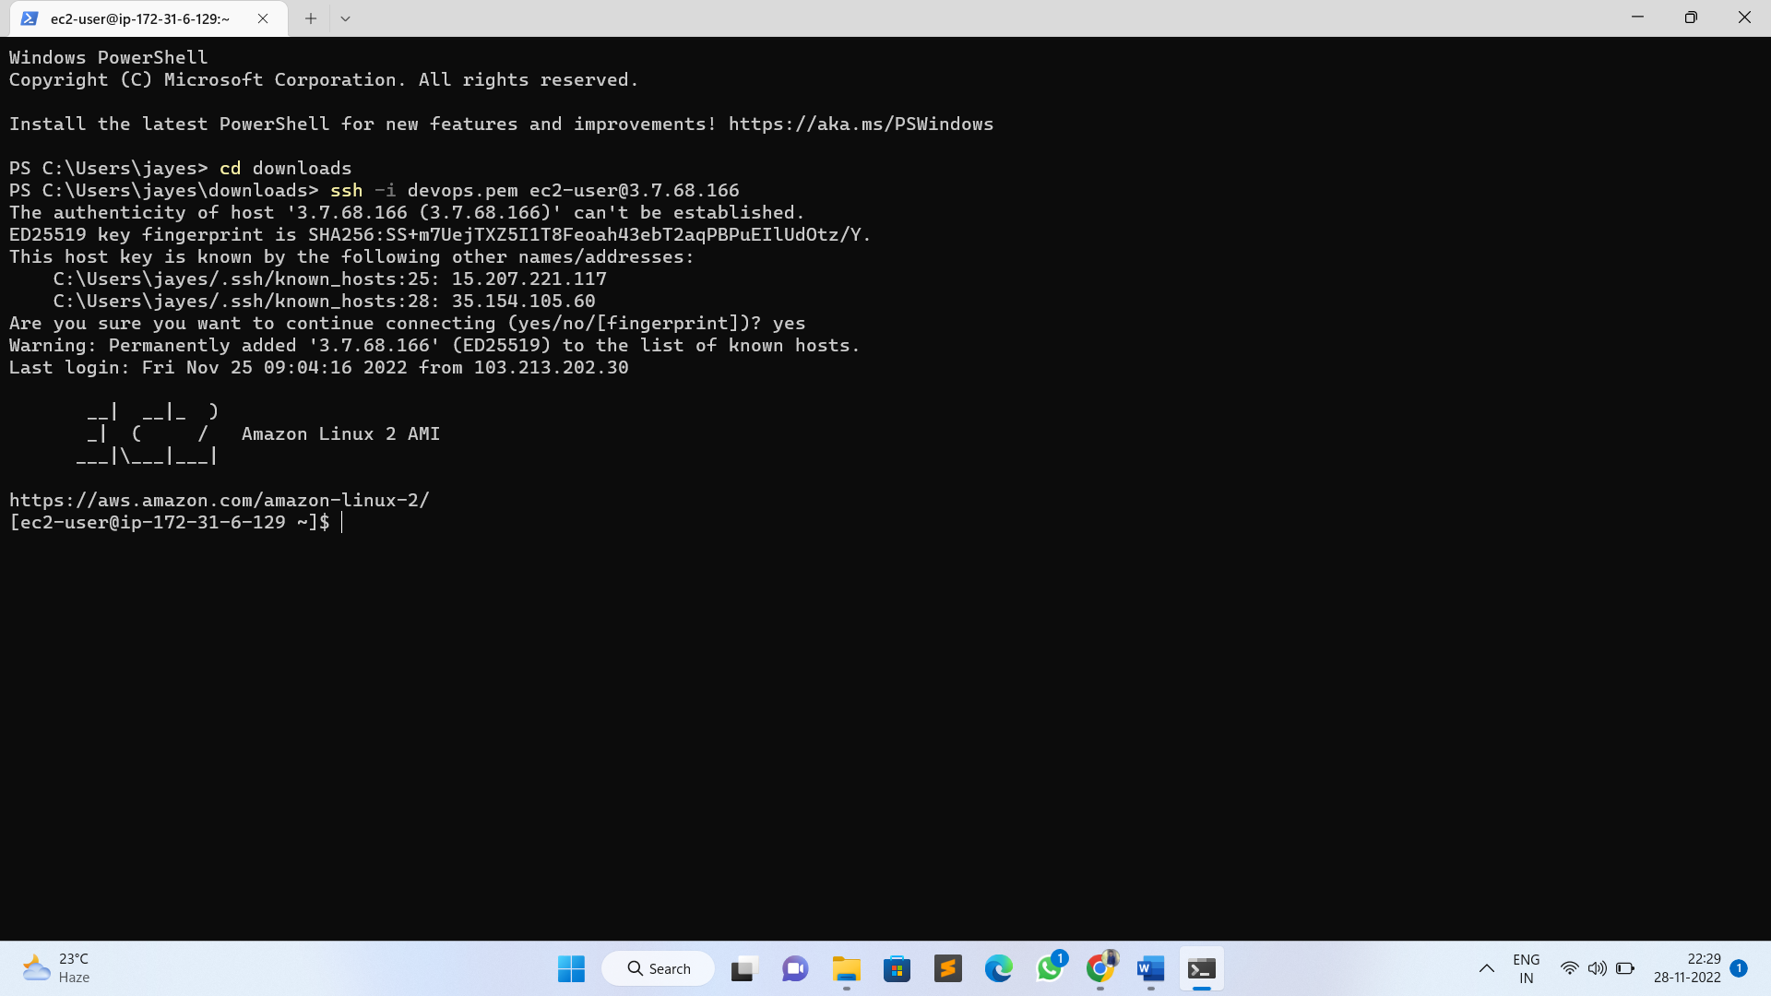
By using SSH command we are accessing our instance in Command Line Interface Terminal.

Slide 12
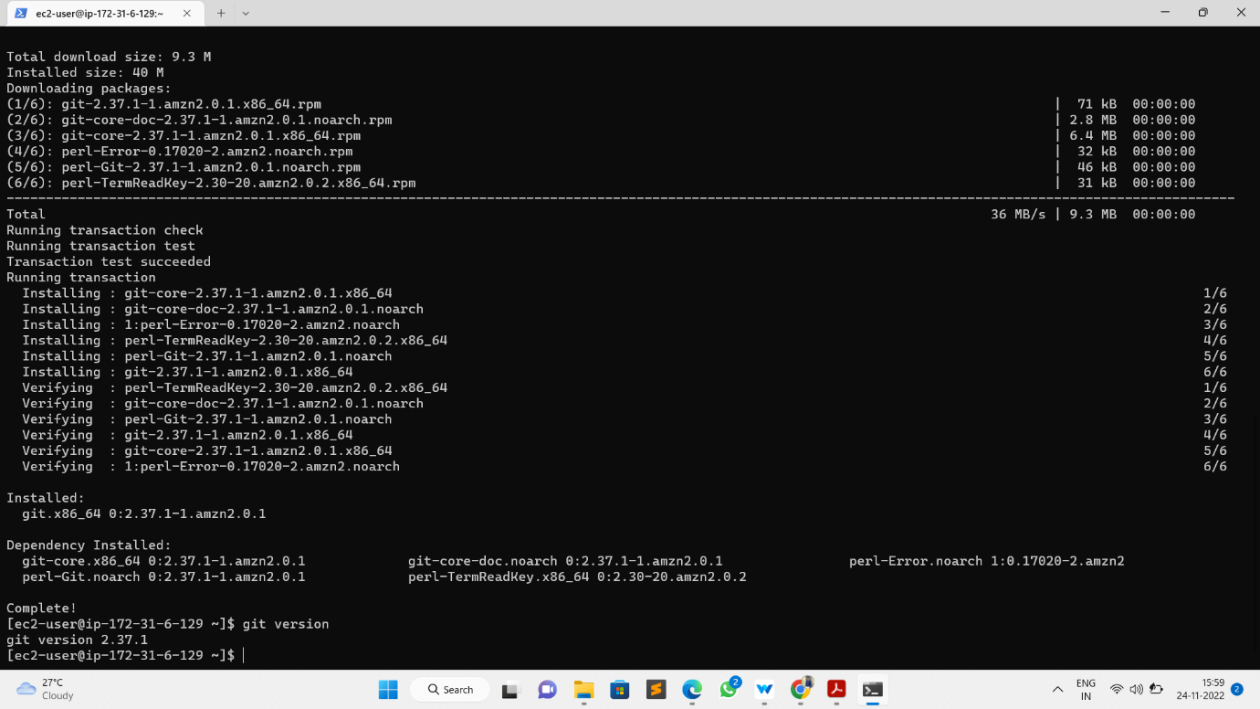
Module – 2: Installing GIT, Docker and related repos
Installing GIT in our instance by using below command
→ sudo yum –y install git

Slide 13
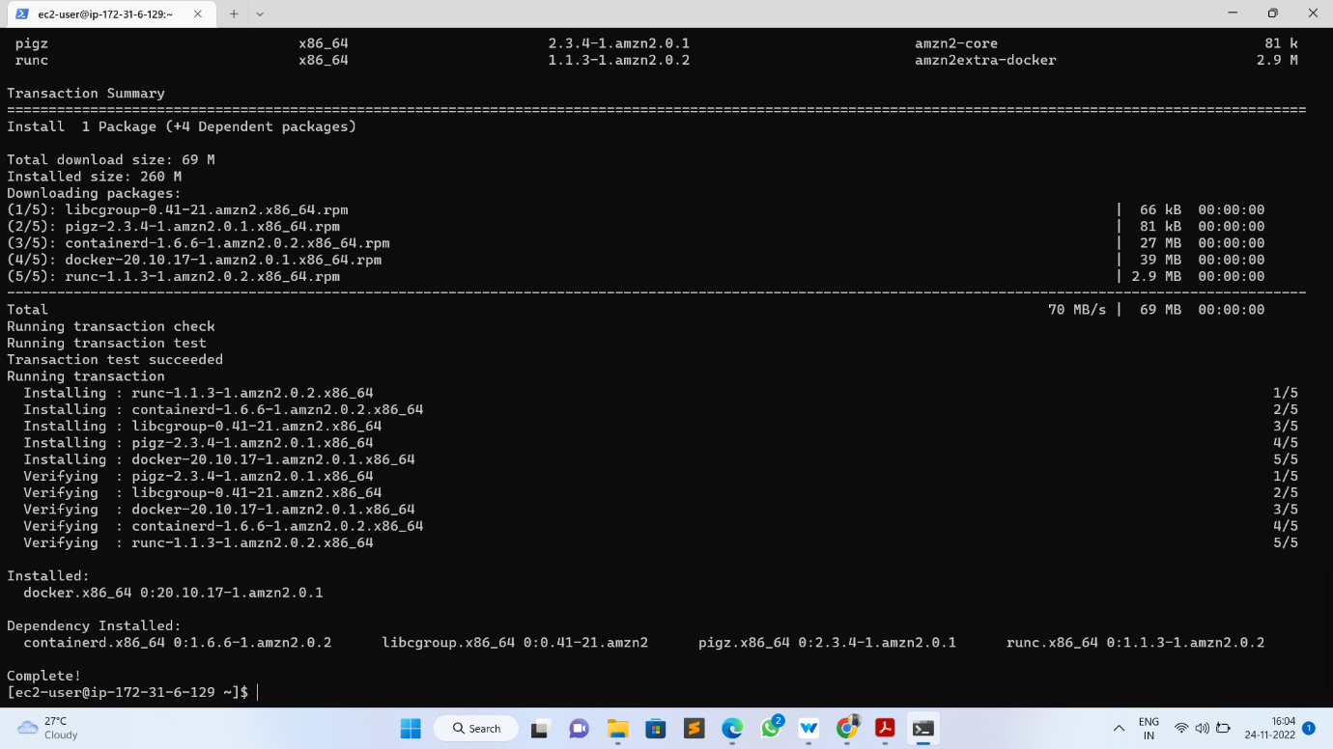
Install docker and docker-compose and required dependencies by using below command. → Sudo yum -y install docker

Slide 14
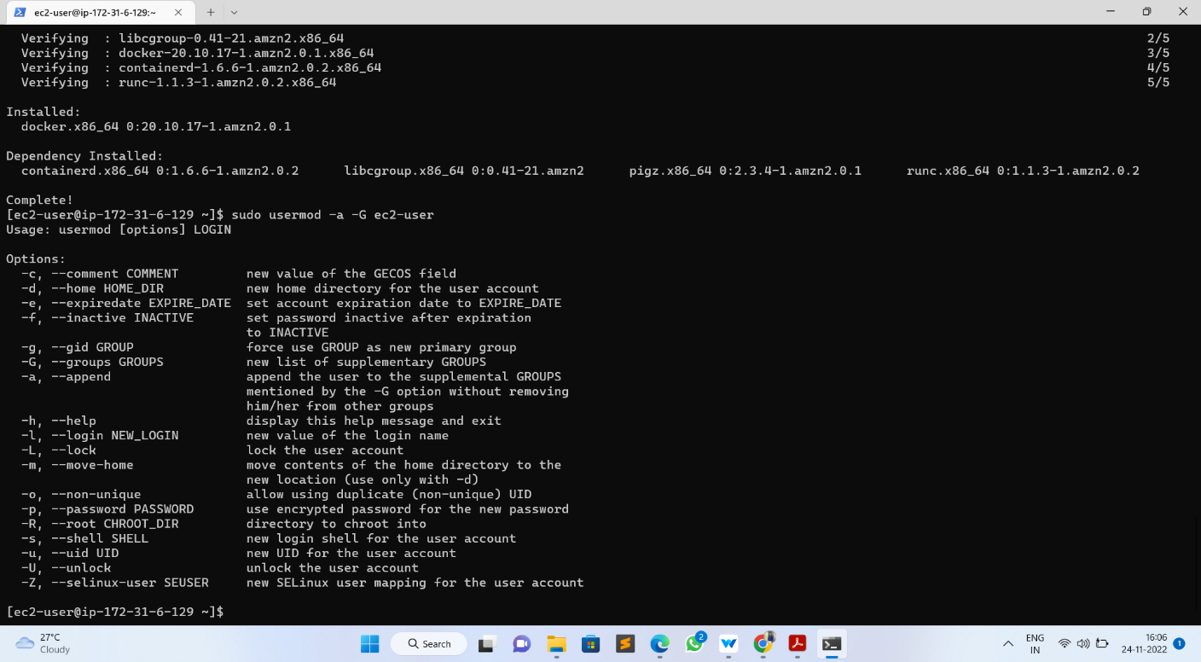
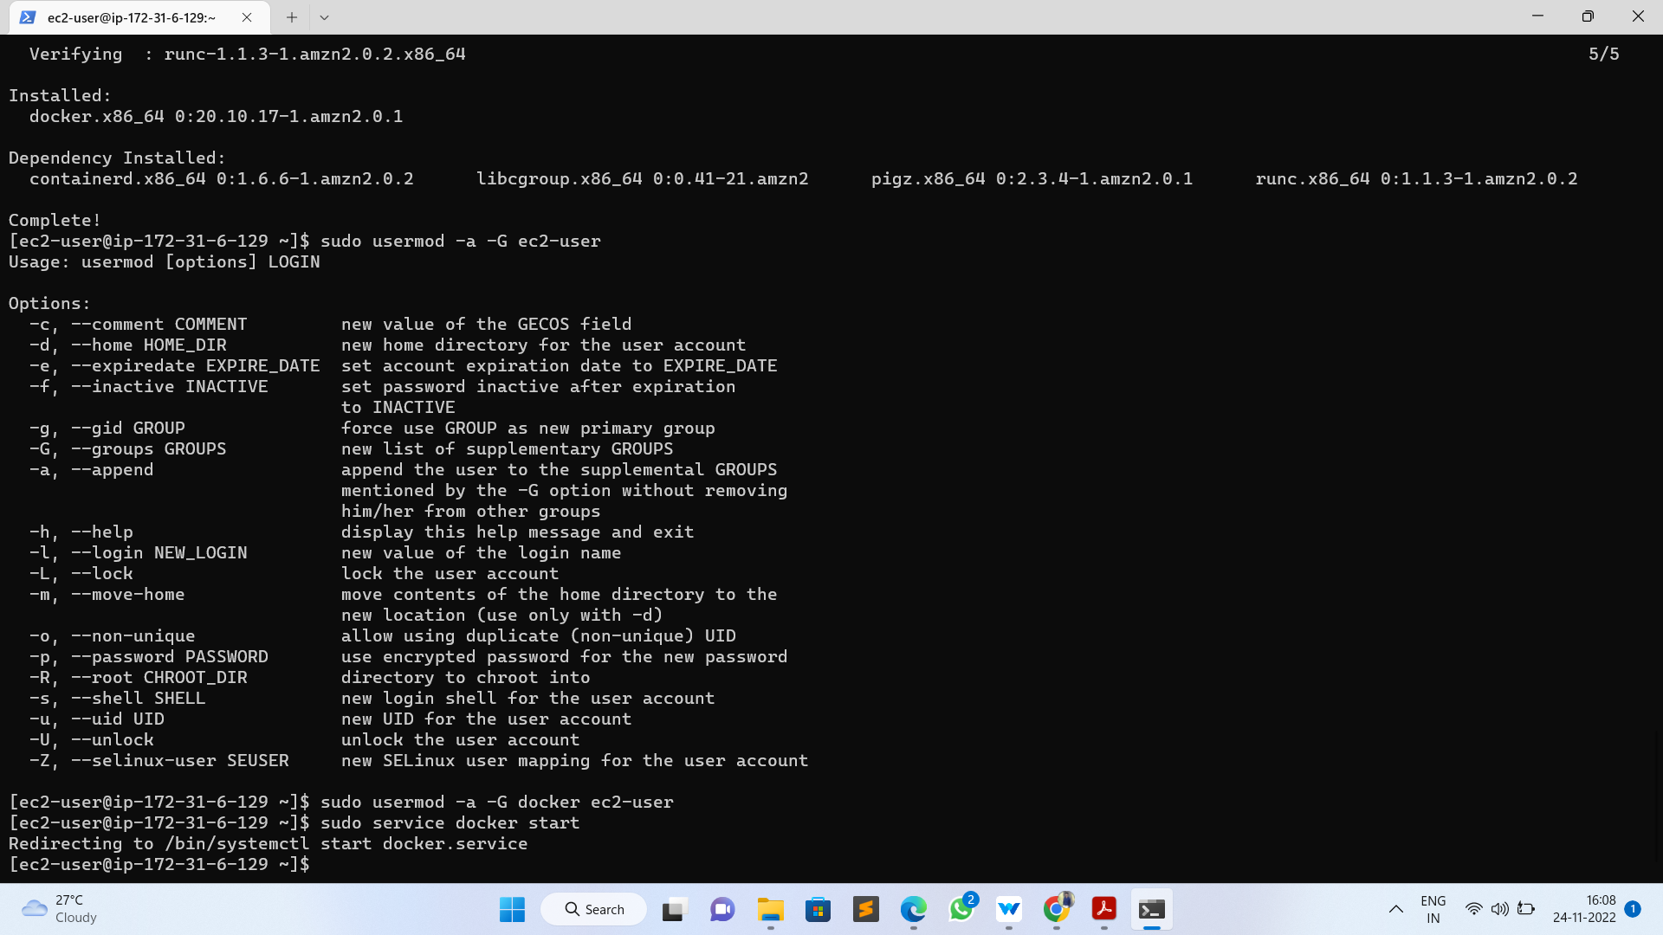
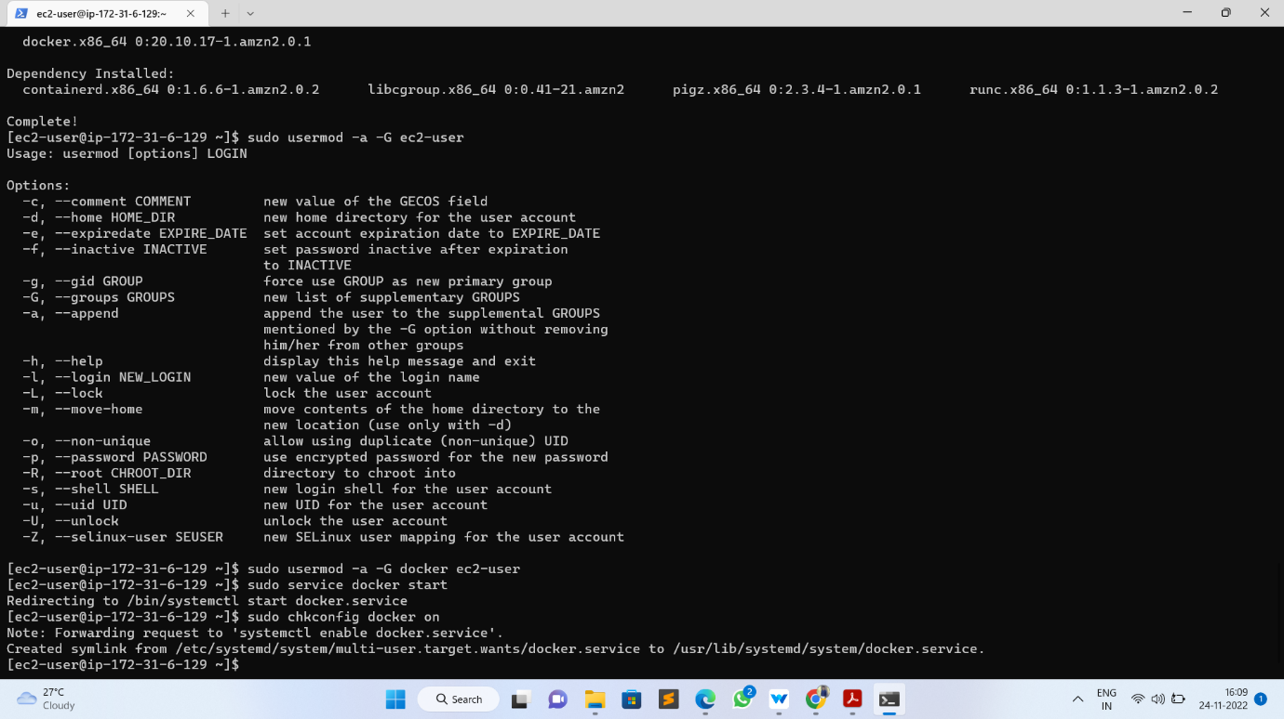
Give the permission to add a limited Linux user account to the "docker" group by using below command → Sudo usermod -a -G docker ec2-user
Start docker service by using below command
→ Sudo service docker start
Run below command to get docker service up automatically after reboot:
→ Sudo chkconfig docker on

Slide 15
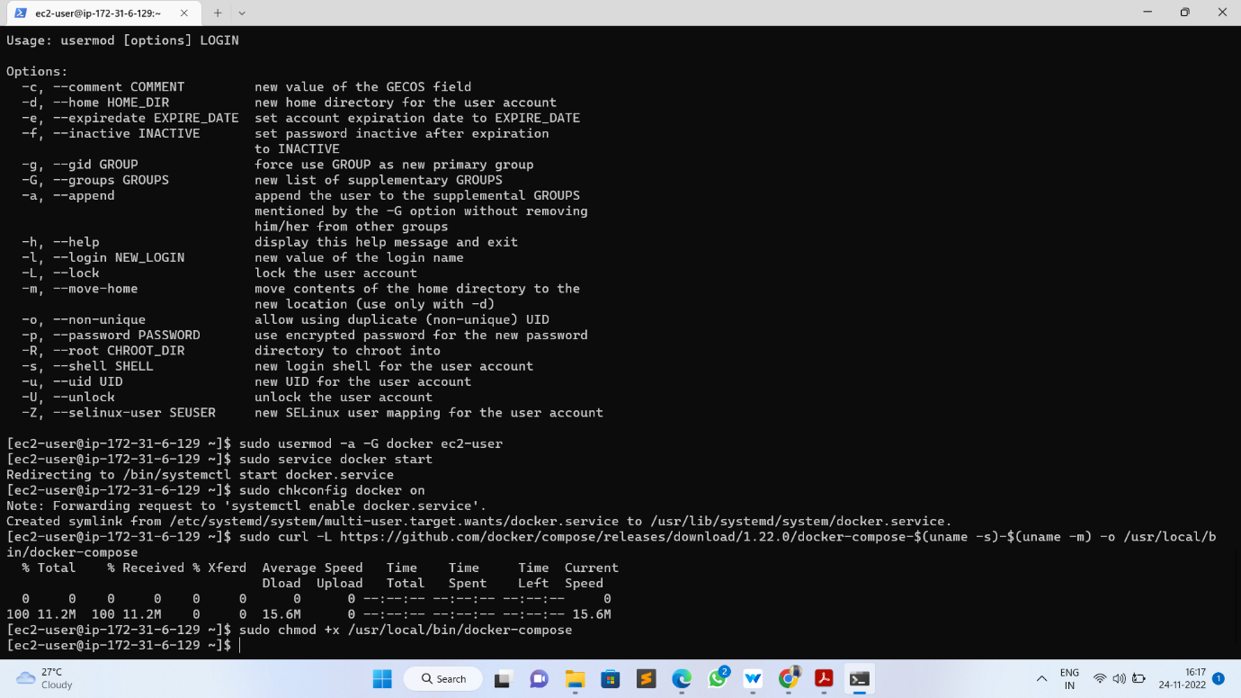
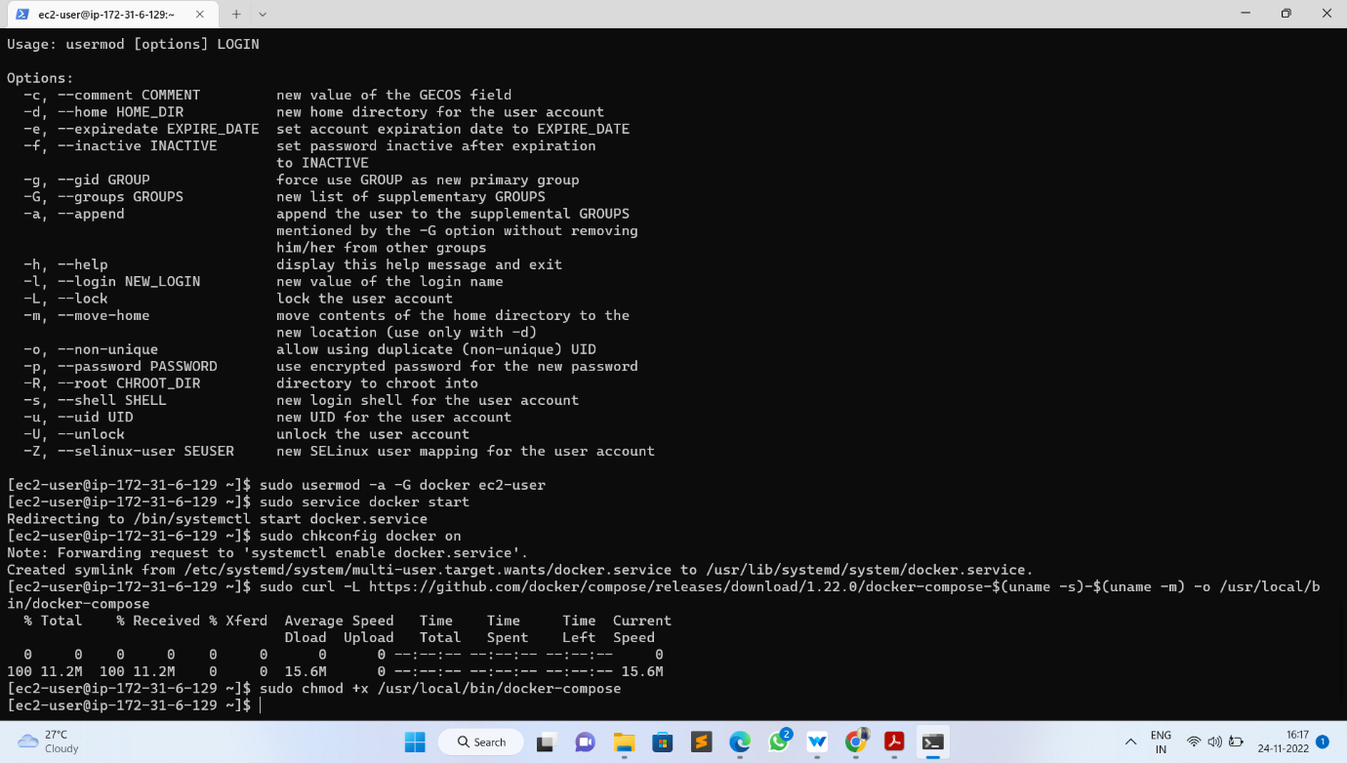
Install Docker Compose
Download the latest version of Docker Compose (Install Docker Compose). Run this command to download the current stable release of Docker Compose by using below command
sudo curl -L https://github.com/docker/compose/releases/download/1.22.0/docker-compose-$(uname -s)-$(uname -m) -o /usr/local/bin/docker-compose
Apply executable permissions to the binary:
sudo chmod +x /usr/local/bin/docker-compose

Slide 16
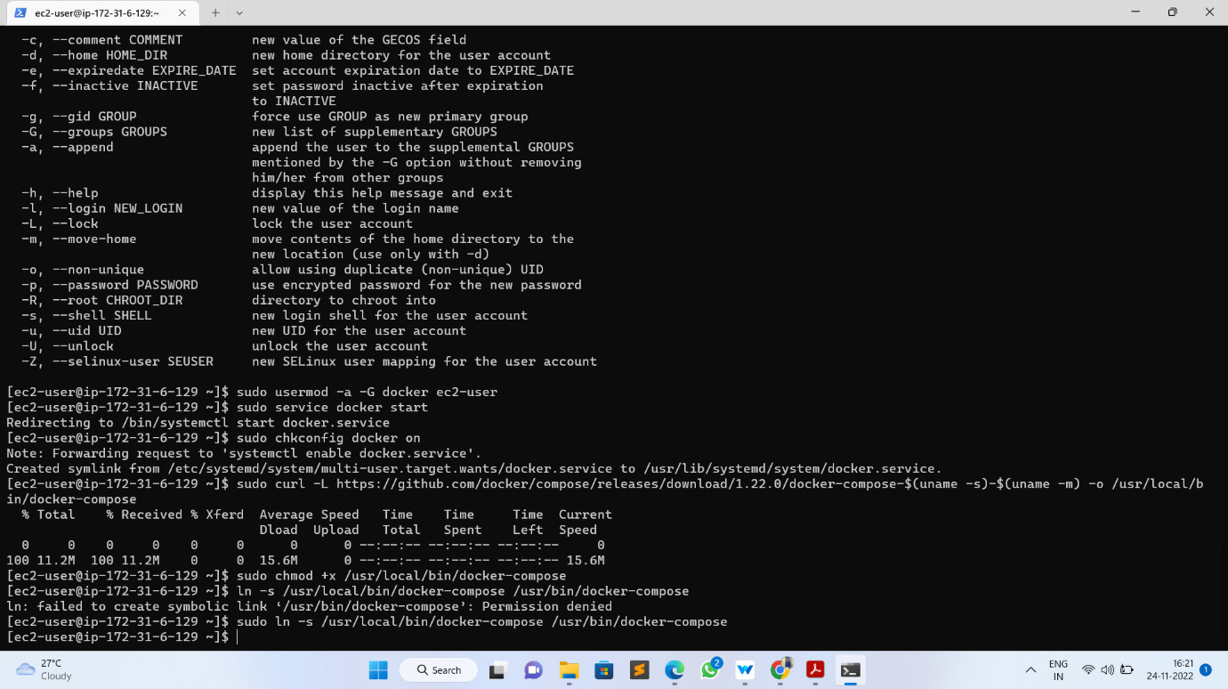
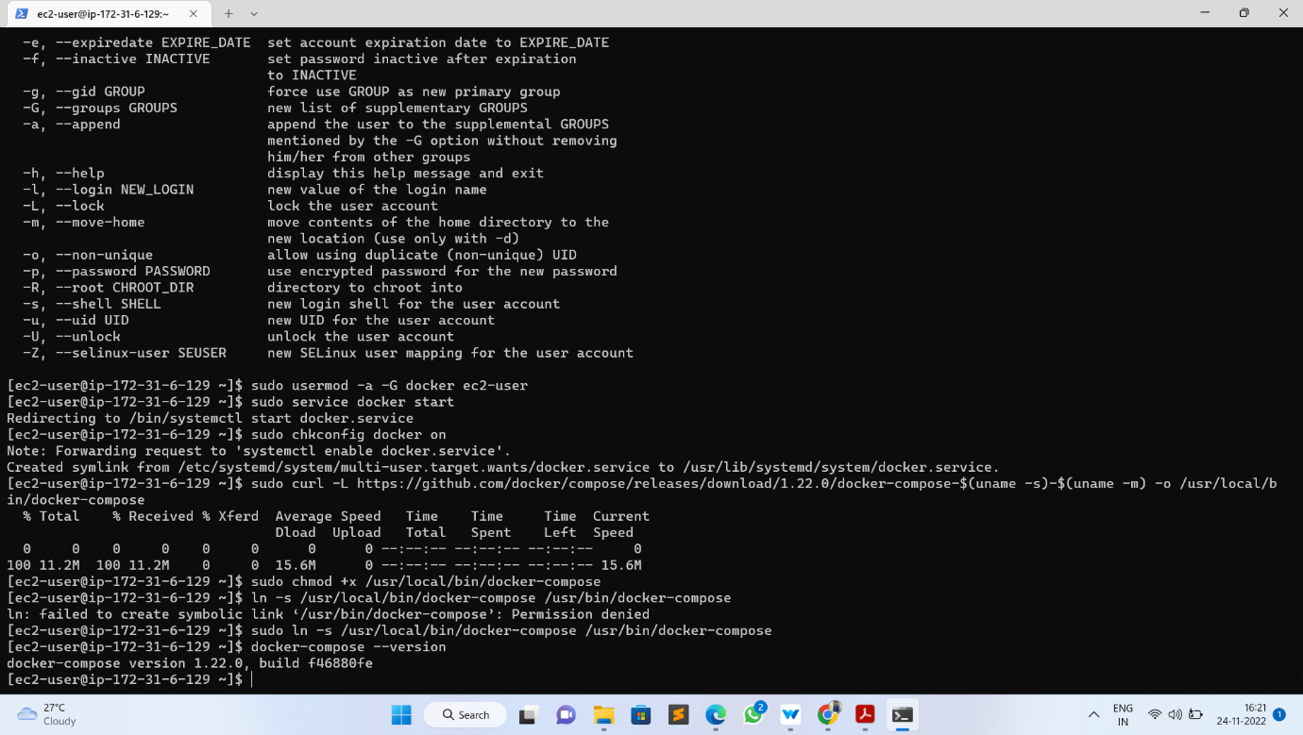
Create a symbolic link → sudo ln -s /usr/local/bin/docker-compose /usr/bin/docker-compose
Check installed docker-compose version
docker-compose –version

Slide 17
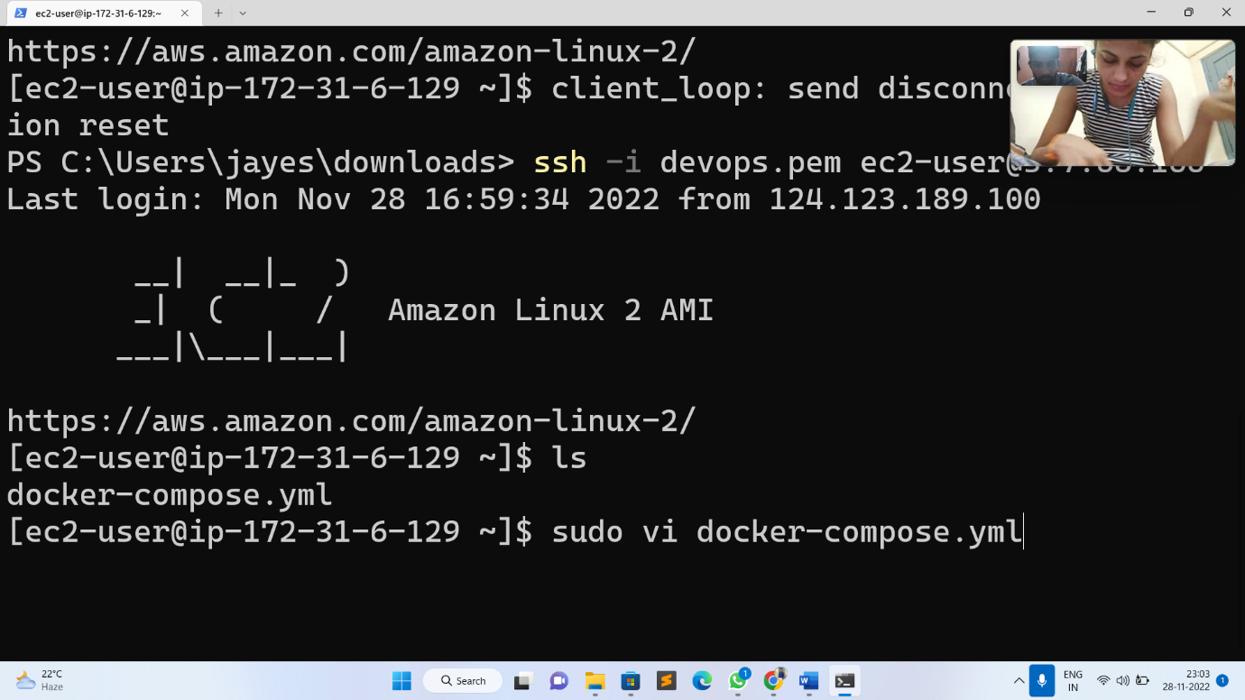
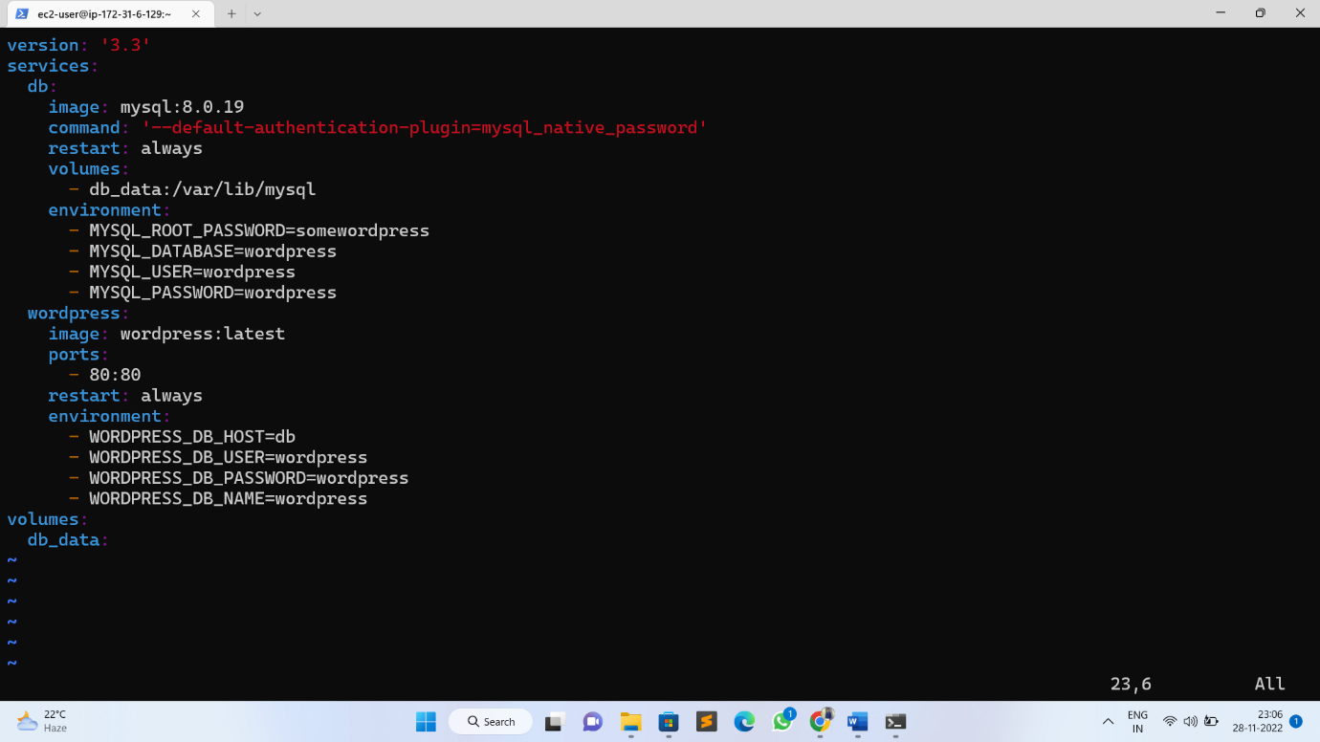
Step 3: Creating WordPress setup for Docker images with help of YAML scripting
Here, we have to create docker-compose.yaml file to pull images from docker hub:
Sudo docker-compose.yml
Here is our docker-compose.yaml file:

Slide 18
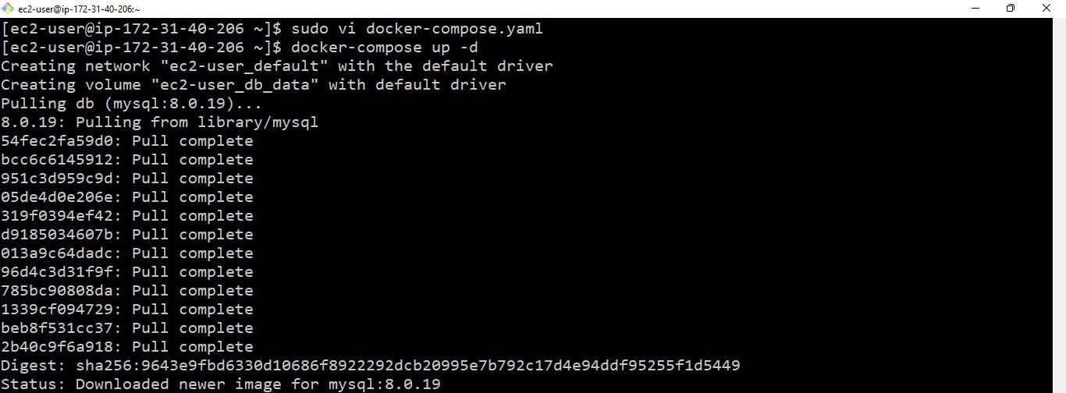
Initially I had a go at running this locally on with Docker Compose →Sudo docker-compose up –d
By using docker-compose.yaml file it was pulling images are MySQL and WordPress

Slide 19
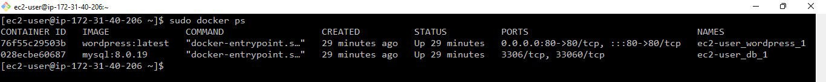
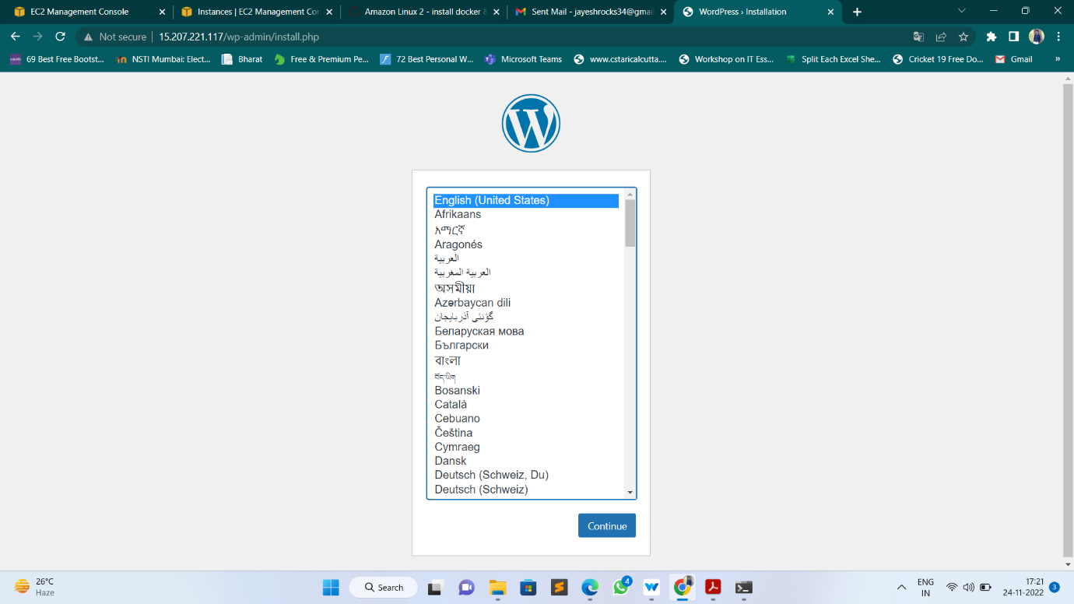
Then I can get the list of running containers by using below command → sudo docker ps
And then lastly, I had a look to see that this was running correctly

Slide 20
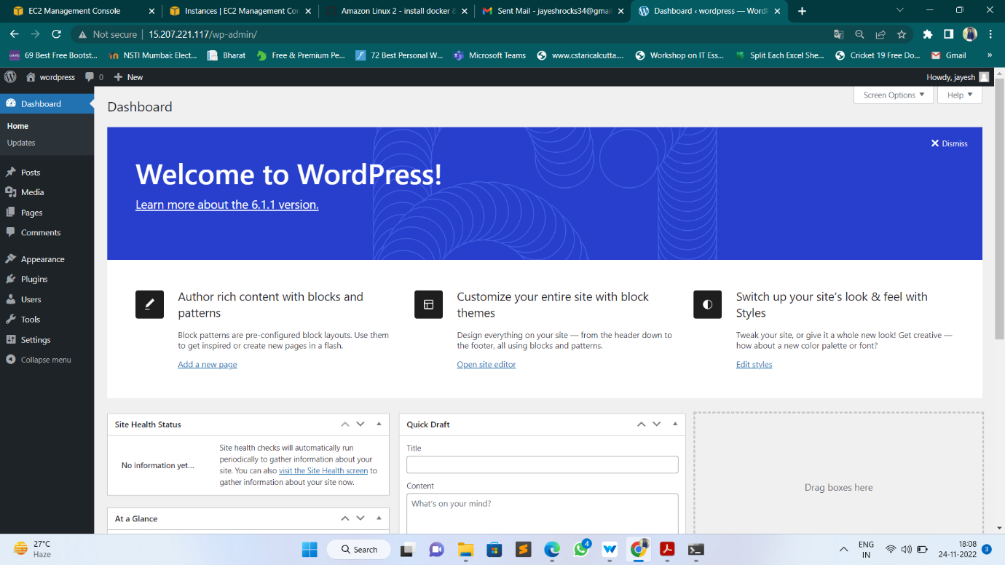
This is the WordPress welcome page.

Slide 21
THANK YOU

